Slide 1
Presenting the Project titled
“ ONLINE MOMOS MINIA ORDERING WEBSITE”
MomosMinia.com
TYCS 2019-2020

Slide 2
INTRODUCTION
The purpose of this website is to outline the parameters under which the principals will pursue the construction, development & operation of franchised Momos Minia Website.The main objective is to make customers happy and making a profit.
Quite simply my aim is to encourage and support the production, vending and consumption of our Momos. Each smaller objective should be geared toward getting new customers and keeping them returning again and again for a scoop of our finest Varieties in Momos.
There is plenty of competition in the various foodie industry. That competition is present all year around. The main purpose of online momos minia ordering website is to develop a general purpose e-commerce store where any foodie such as(varieties in momos,etc)can be bought from the comfort of home.

Slide 3
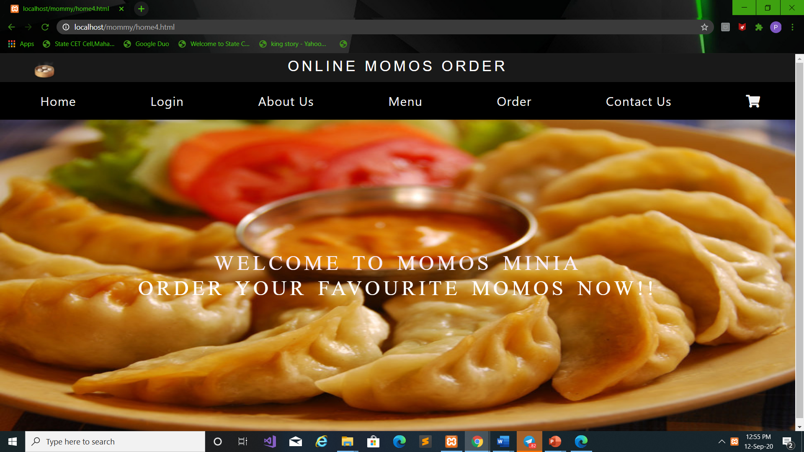
HOME PAGE

Slide 4
CURRENT AND PROPOSED SYSTEM
CURRENT SYSTEM
The current system includes very tremendious complex work. The system is portable & scalable so that support users increased significantly & can be adapted to any establishment.
Like we see that in shops many shopkeeper who used to record their shop details like client orders, rates, discount rates, etc. This involves a lot of paperwork and carries a difficult task. For calculating the amount of bill many shopkeeper uses a calculator.
Limitations of current system
TIME CONSUMING
LESS SECURITY
WASTE OF PAPER
DIFFICULT TO SEARCH & REMEMBER THE DETAILS

Slide 5
PROPOSED SYSTEM
The proposed system process provide a user friendly GUI that will help data entry.It’s main aim is to reduce the difficulty of remembering the details and manage the shop details easily.The developed system will be a time saving application for the user. The system makes the overall project management much easier and flexible. It can be assessed over the internet.
Advantages of proposed system
Accuracy & reliability
User friendly
Less time consuming
No use of calculator
Reduce human effort
No paperwork

Slide 6
HOME PAGE

Slide 7
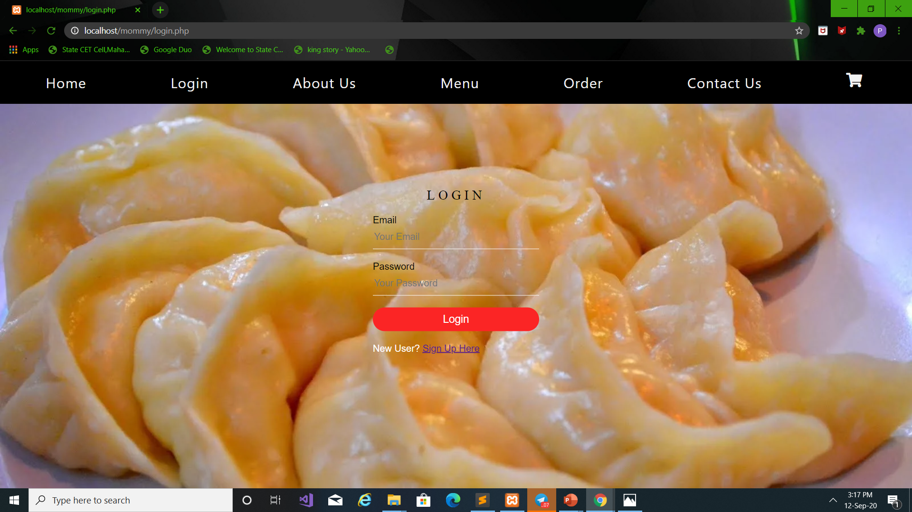
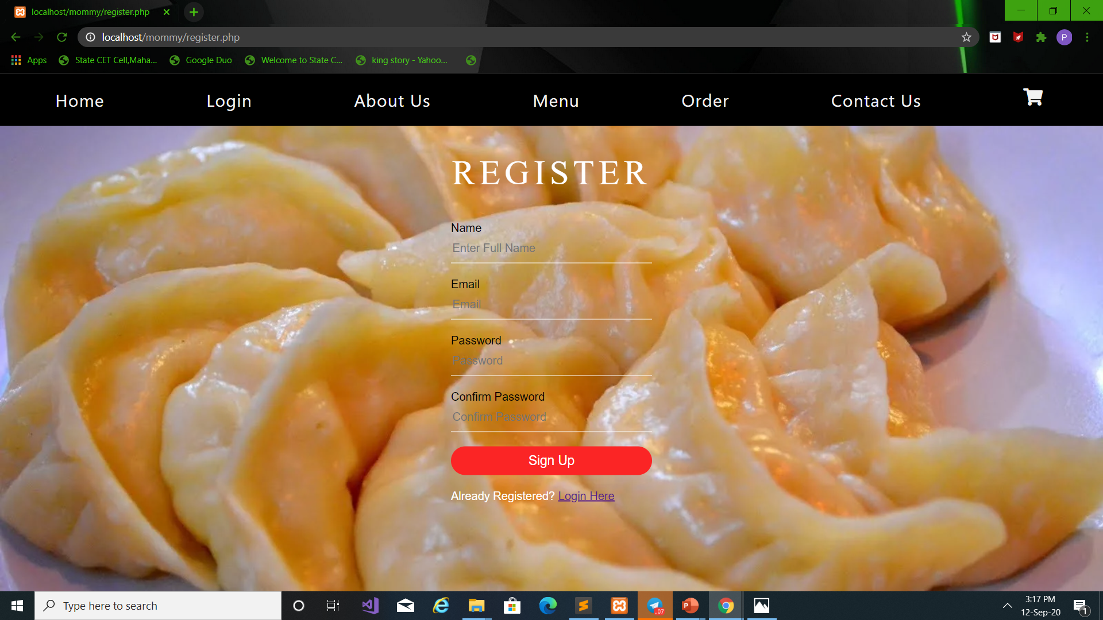
LOGIN AND REGISTER PAGE

Slide 8
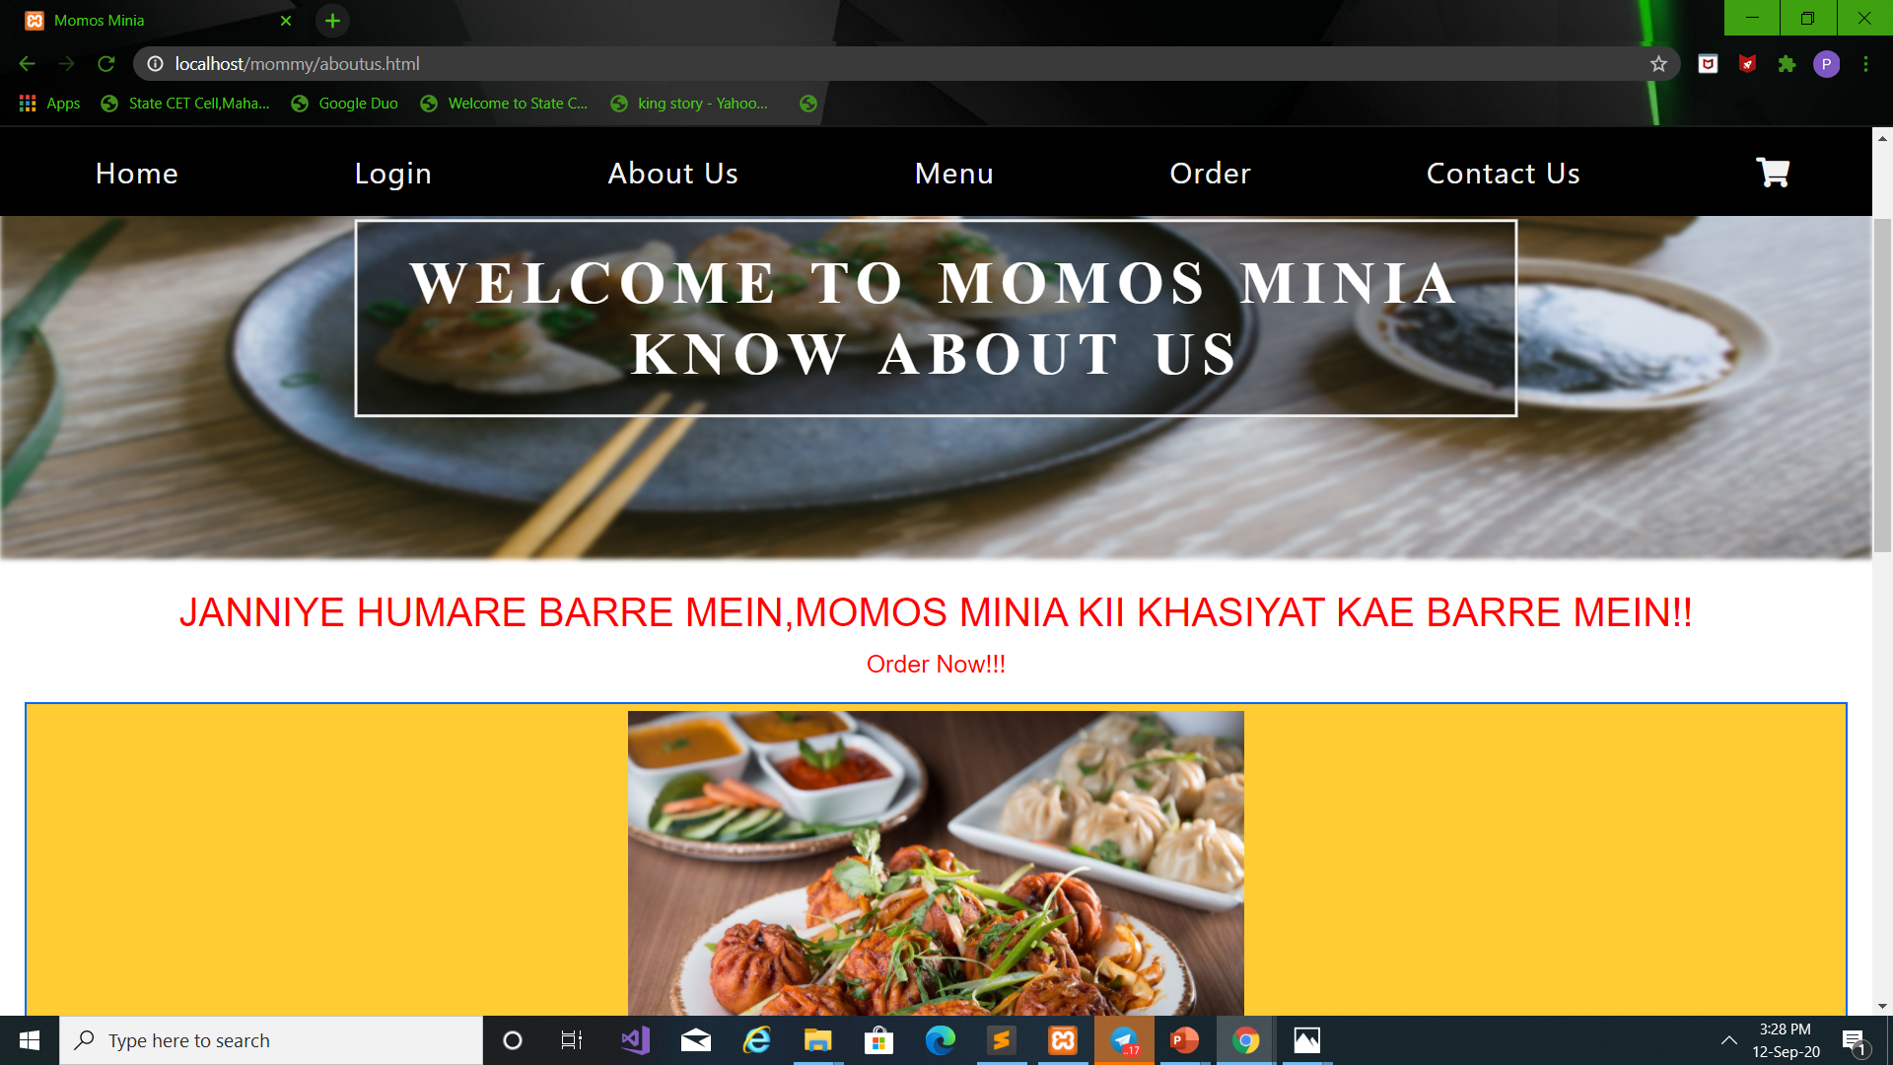
ABOUT US

Slide 9
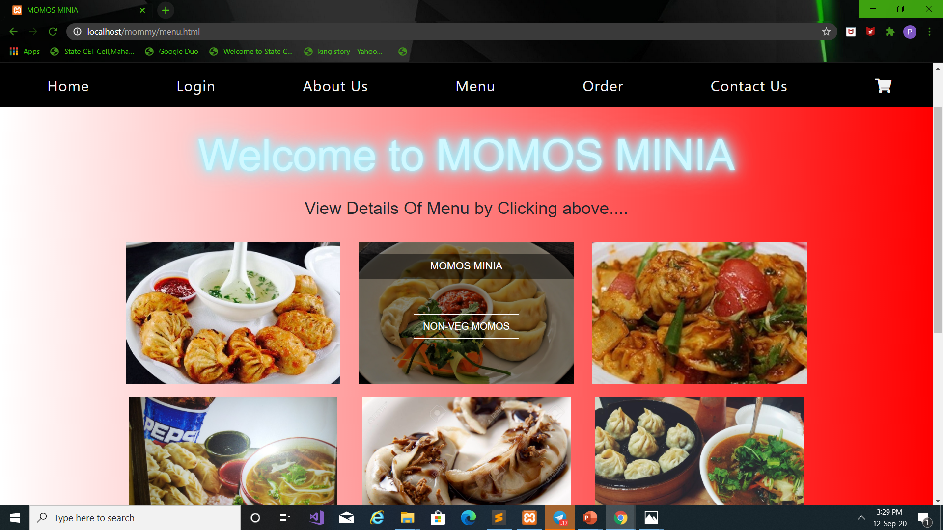
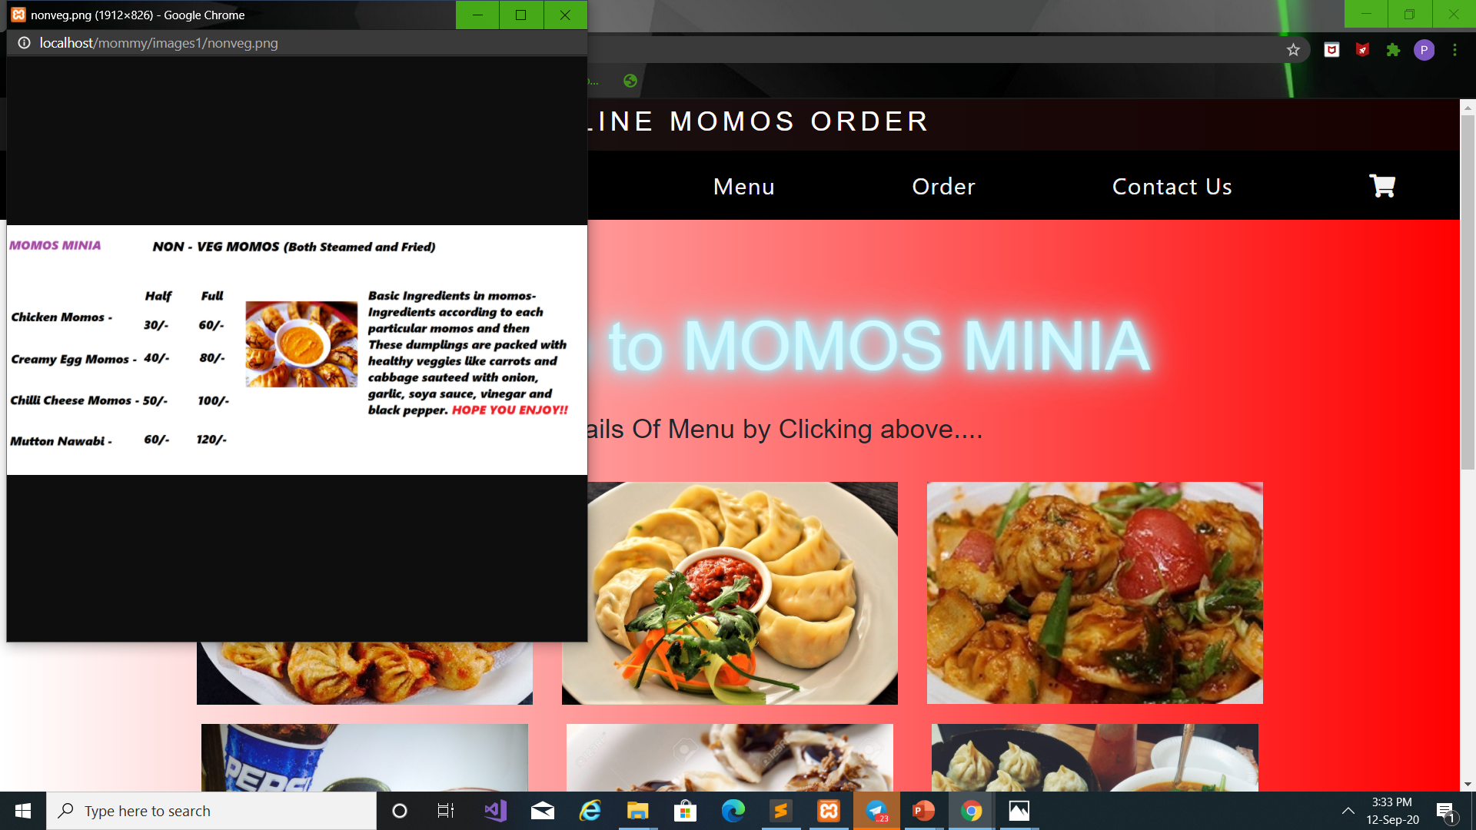
MENU PAGE

Slide 10
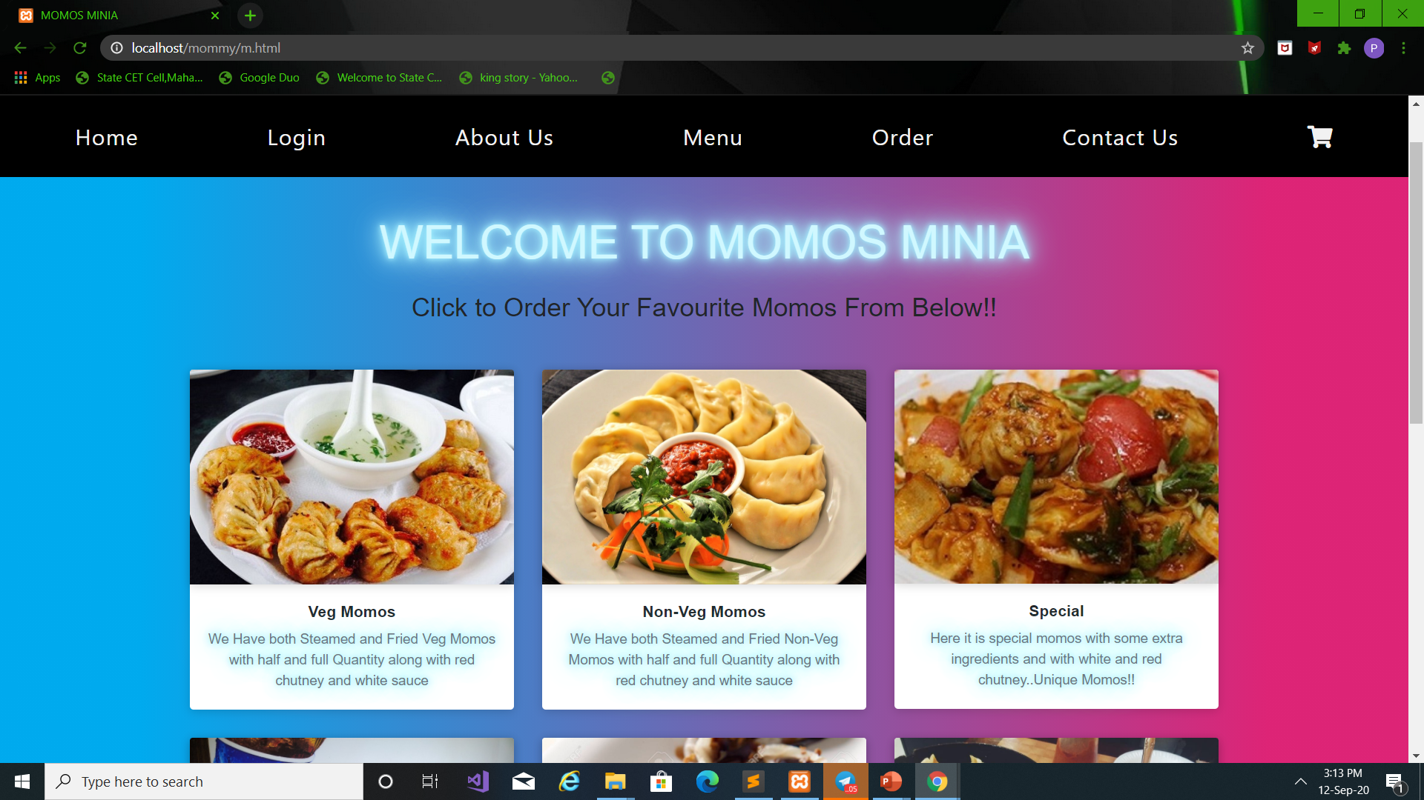
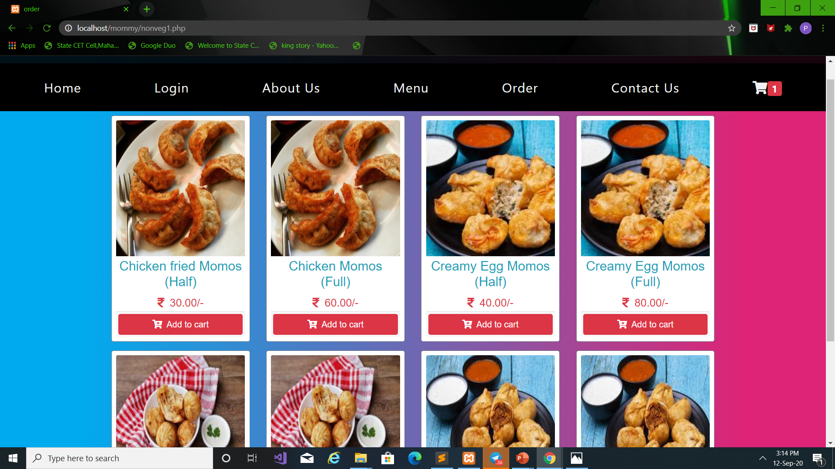
ORDER PAGE

Slide 11
LOGIN AND REGISTER PAGE

Slide 12
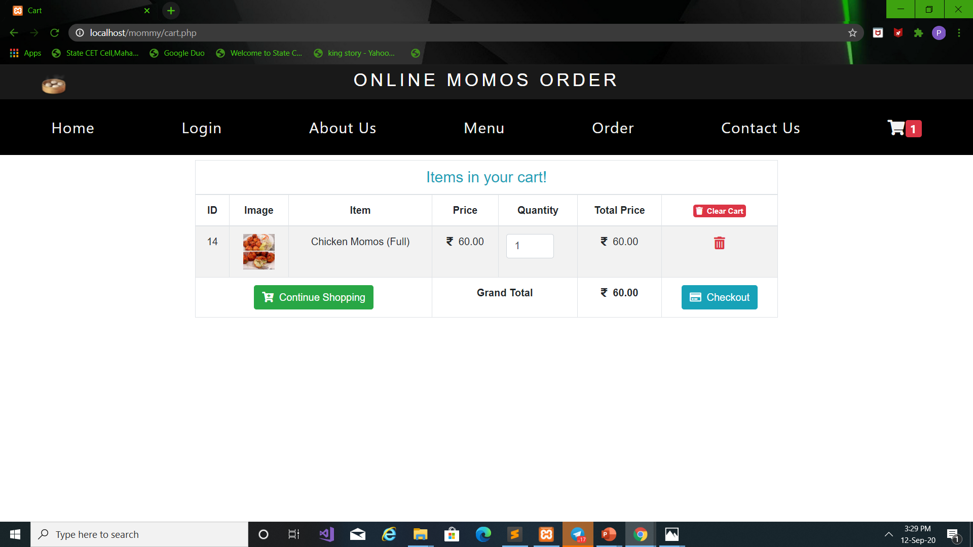
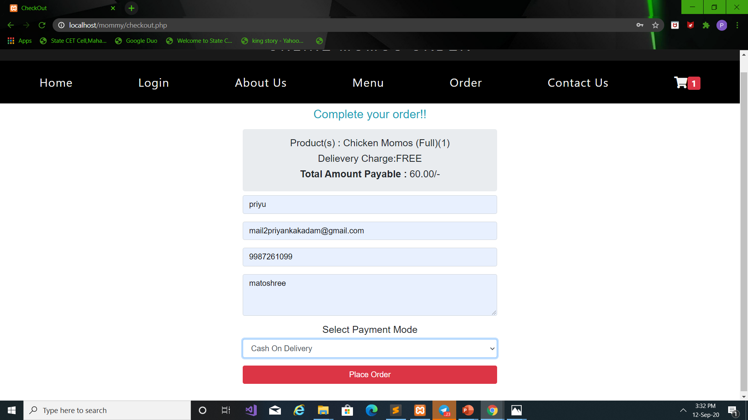
Checkout

Slide 13
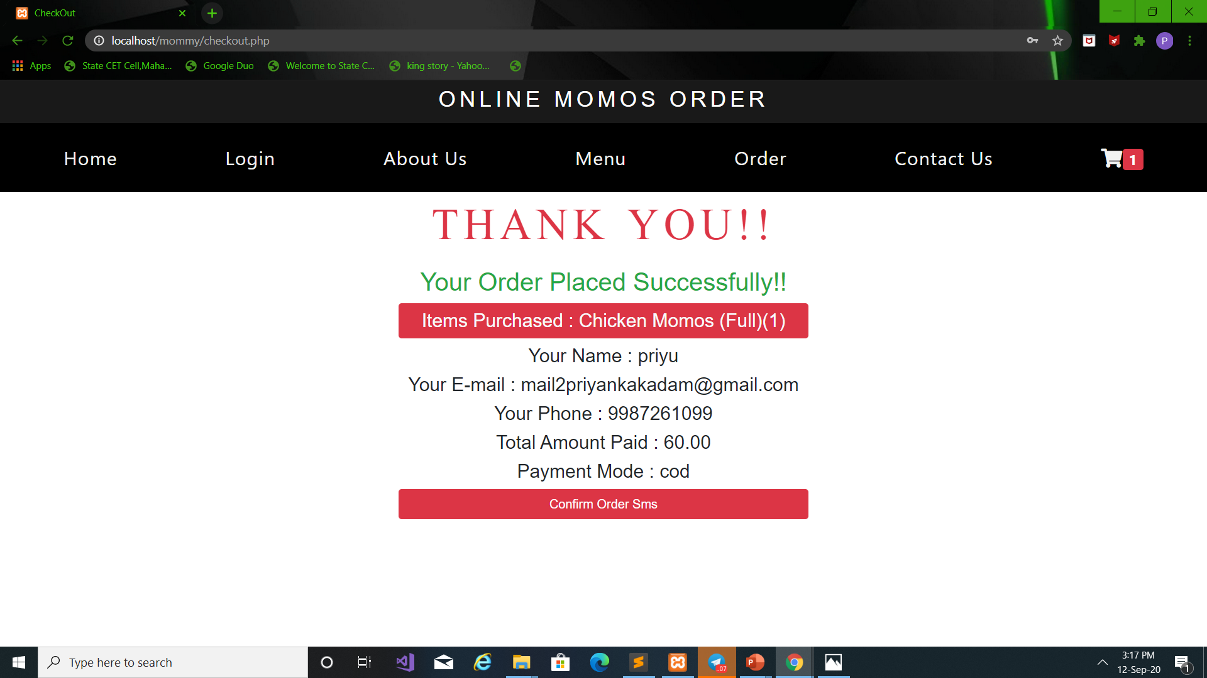
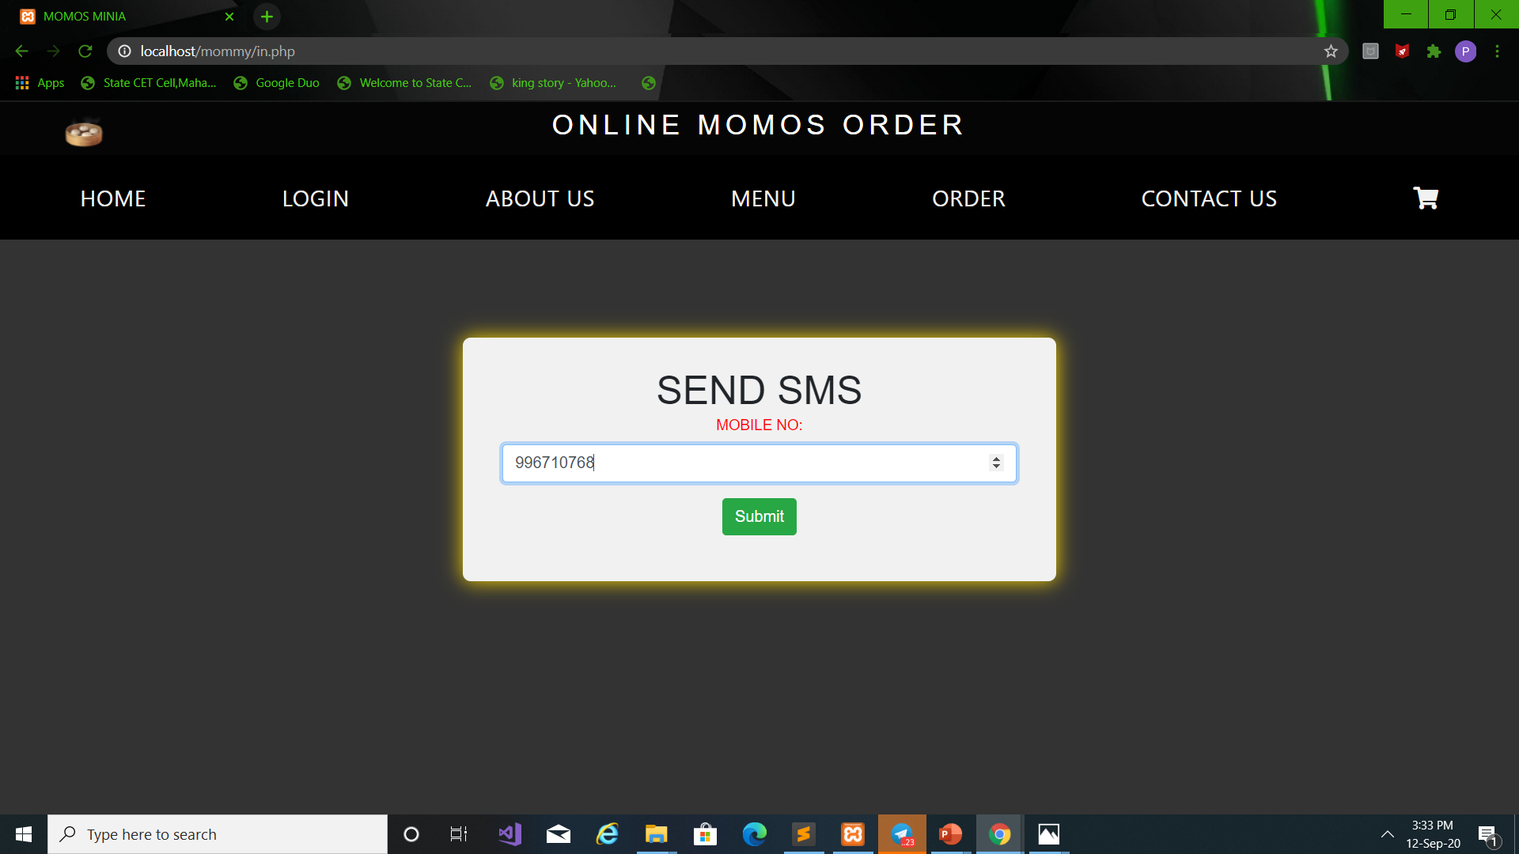
Place Order

Slide 14
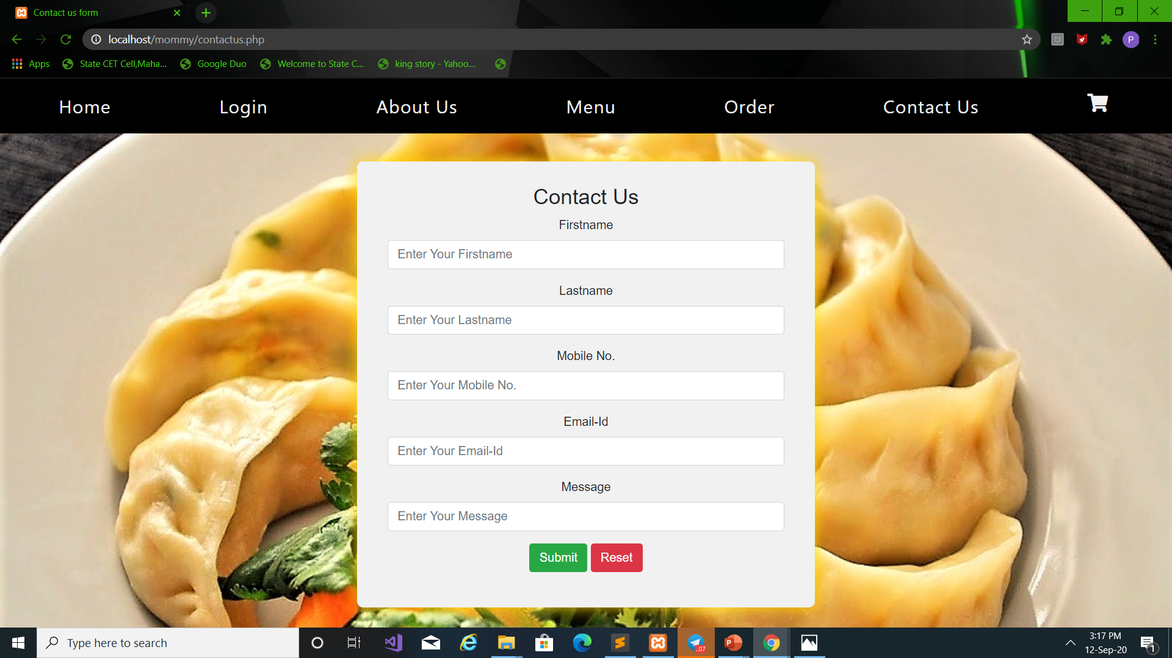
CONTACT PAGE

Slide 15
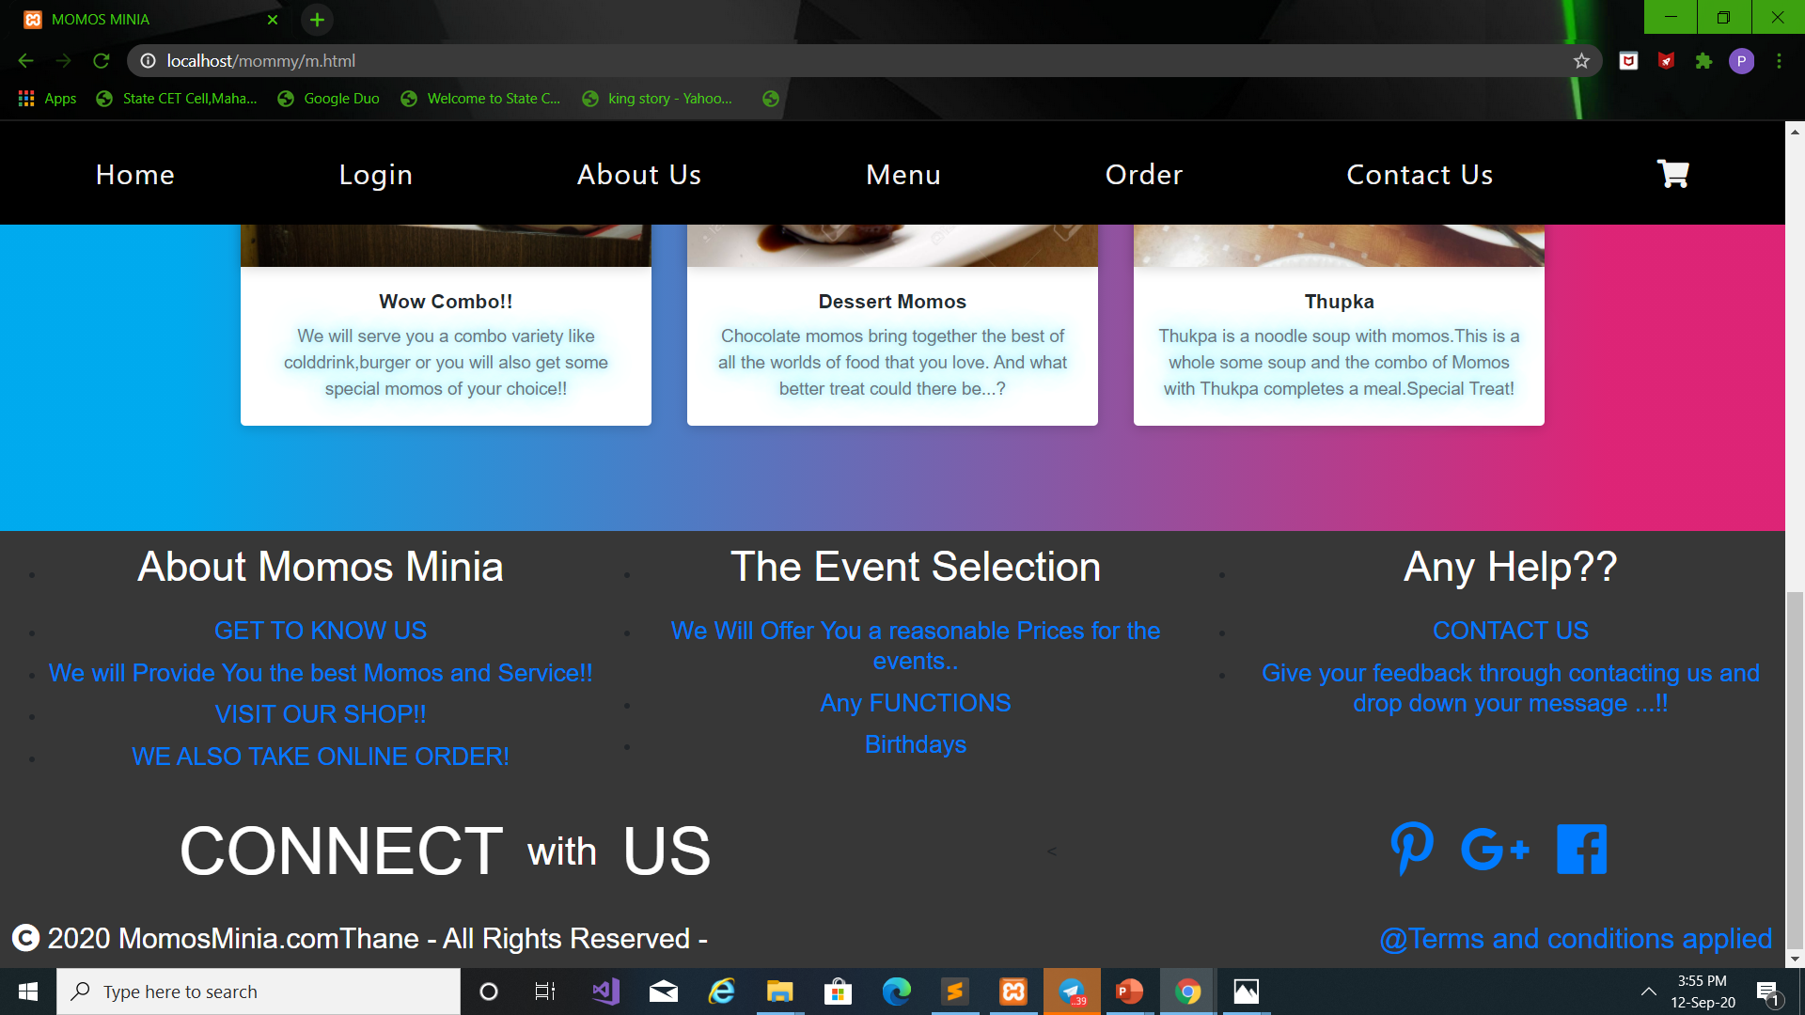
FOOTER

Slide 16
THE END
THANK YOU

